Slide 1
Catchment Conundrums

Slide 2
Definition
“distinct unit wherein hydrologic processes take place. A catchment is commonly recognized as the basic unit of study, management or reporting in hydrology, and multiple and differently represented in the real world. A catchment is part of a containing catchment, in a nested or aggregate hierarchy of catchments, as typically used for high order organization of management and reporting units.”
Do we need to clarify whether its the entire area for an outflow… D. Maidment also talked explicity about a “catchment to a line” – so clearly we need to handle both cases – but how and with what terminology..

Slide 3
Catchment models
A
B
A
B
C
C
Arbitrary Catchment “A+B->C”
Dendritic if Outflow is inflow of 0..1 catchments
Linear references not supported.
Linear referencing model
Dendritic if:
Catchment has 1 inflow – 1 outflow
1 outflow has many contributing catchments
Outflow is inflow of 0..1 catchments
Area assignment arbitrary between
“conjointCatchments” AC and BC

Slide 4
Flexibility and ambiguity.
Catchment AB->C contains AC and BC
So – modelling for linear referencing doesn’t stop us modelling areas as well – but need to recognise these are different kinds of things – and hence we need terminology available.

Slide 5

Real world complexity: area is _always_ arbitrary
A
B
A
B
Water bodies
C
C
Diffuse connections
(swamps etc)
A
B
A
B
C
C
Flow-regime dependent channels

Slide 6
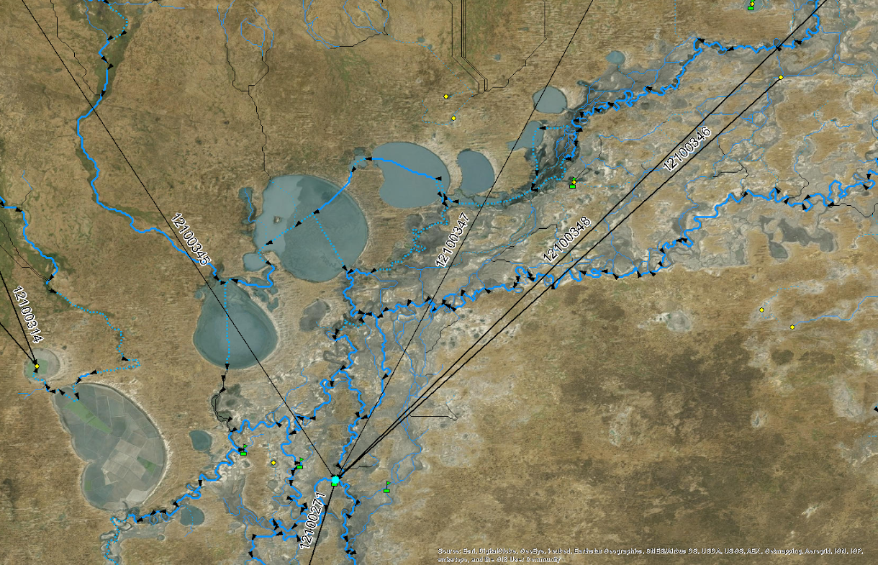
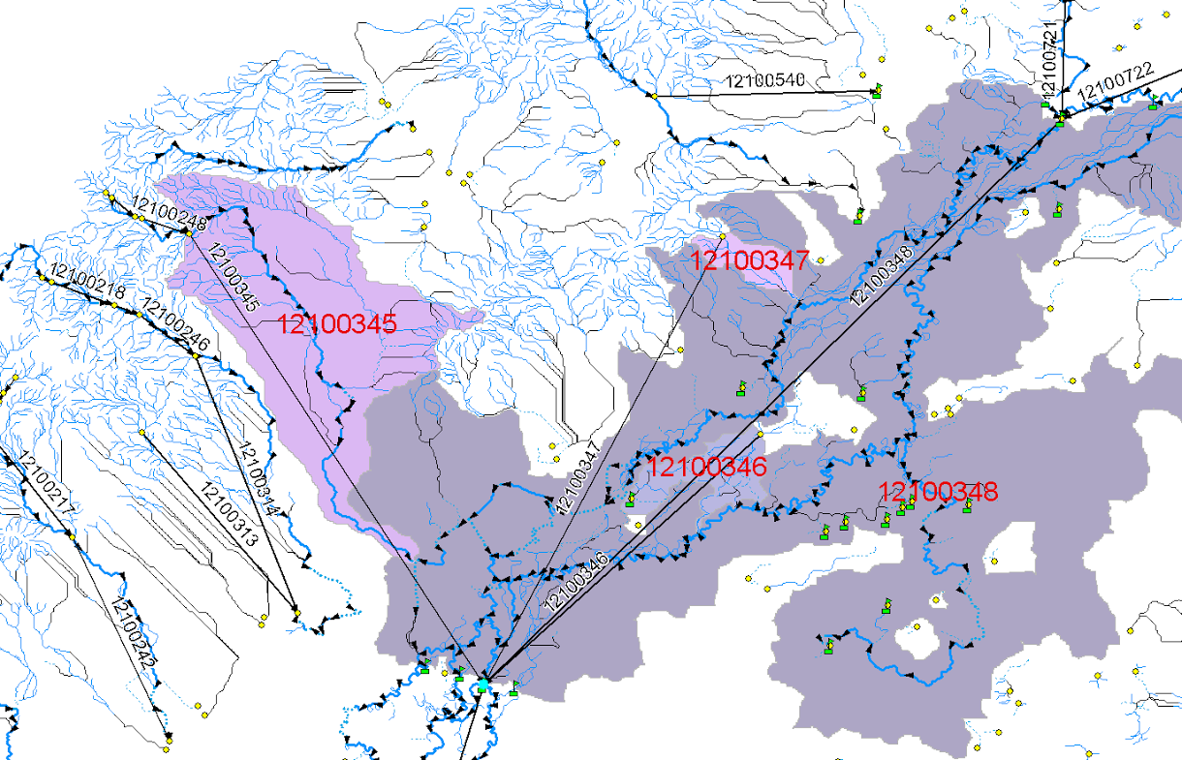

Slide 7
Modelling options
No model
User needs to download details and check before making any assumptions about area. Only safe area operation is to dissolve all catchments with same outflow node into an arbitrary catchment before doing area operations.
2. Simple association
Catchments need to be augmented with associations
User can get details to determine how catchments interact
AC
conjointCatchment
BC
conjointCatchment
3. Association class
Extensible placeholder for more details
Can be retrofitted to any product
User needs to know where and how to find this information

Slide 8
Modelling options 2
A
B
C
Association class
AC
BC
sourceCatchment
targetCatchment
<<CodeList>>
FlowType
HY_interCatchment
interactionType:FlowType
Bi-directional – but repeated for different flow regimes.. Just a choice!
<<CodeList>>
myList
My_model
percentLR:Real
percentRL:Real
flowThresholdMin:Real
flowThresholdMax:Real
Noflow
Normal
Flood

Slide 9
Usability..
UML association class – can be modelled directly on the association…
What is the status of this in the ISO modelling
How hard to subclass in practice – support in tools?
How to handle this in mappings?
RDF equivalent – reification
Object Predicate Subject .
myP a Predicate
Source:A
Target:B
myProperty1: “some more information about this instance”
Can use both (does an association class collapse to supporting both cases in the encoding?)
What if nothing found for a individual feature – 0 or null?
Can look at mapping model for product and see if there is an attribute mapped to conjointCatchment

Slide 10
Why now?
Because this is just “glossed over” in most data products?
Can be abstracted out by choice of spatial scale
Do hydrologists care enough – and if so – how do they handle it with existing products?
Should we care? Seems useful to understand basic definitions – so we might as well deal with it in as simple a fashion as possible – extensible placeholder

